Slide 1
NextHikes IT Solutions
Project 2
Building Basic Calculator using python & tkinter Library
Lokesh Lavhate
20/02/2026

Slide 2
Introduction
Calculators are essential everyday tools
Motivation: combine Standard, Scientific, Converter in one app
Goal: user‑friendly, professional design

Slide 3
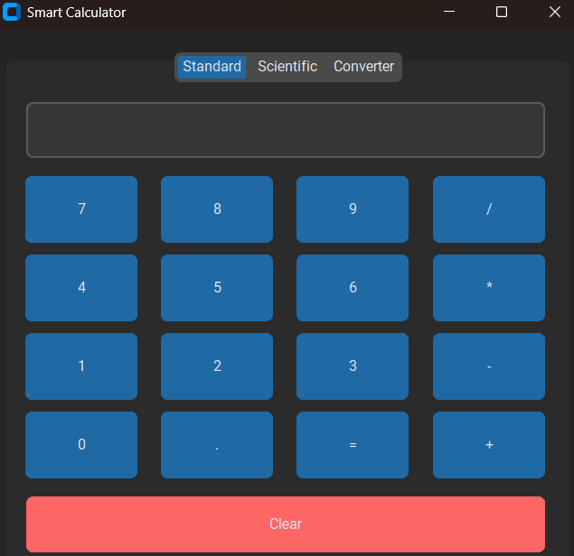
Objectives
Build three tabs: Standard, Scientific, Converter
Ensure error handling and clear feedback
Add keyboard operability and usability features
Provide modern GUI with CustomTkinter

Slide 4
Tools & Technologies
Python 3 programming language
CustomTkinter for modern GUI
Regex for parsing trig functions
Math module for scientific calculations

Slide 5
Standard Tab Features
Basic arithmetic (+, −, ×, ÷)
Clear button for reset
Keyboard shortcuts supported
Simple aligned layout

Slide 6
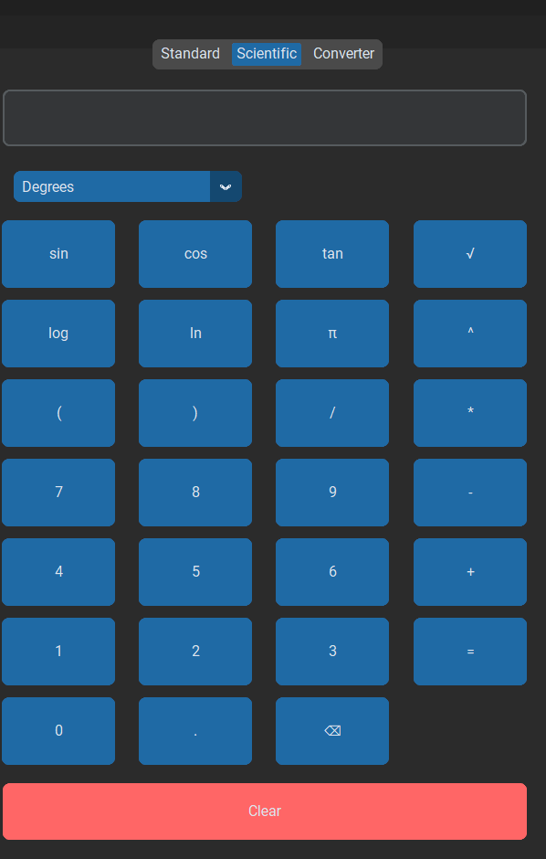
Scientific Tab Features
Trigonometric functions: sin, cos, tan
Degrees ↔ Radians toggle
Logarithmic functions: log, ln
Symbols: π, √, ^, parentheses
Backspace button for corrections
Keyboard shortcuts for functions

Slide 7
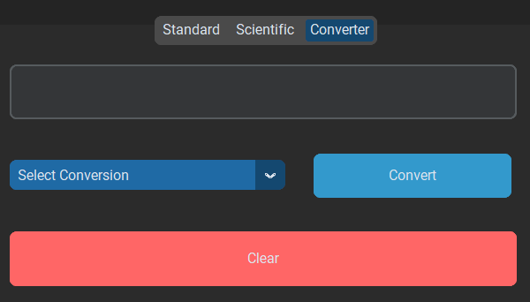
Converter Tab Features
Unit conversions: meters→cm, kg→pounds, °C→°F
Currency conversion: USD→INR
Dropdown menu for easy selection
Clear button for quick reset

Slide 8
Error Handling & Status Bar
Unknown function → “Unknown Function”
Division by zero → “Division by Zero”
Invalid input → “Invalid Expression”
Status bar shows mode and feedback

Slide 9
Keyboard Operability
Enter → evaluate
Esc → clear
Backspace → delete last character
Ctrl+1/2/3 → switch tabs
Shortcuts: s=sin, c=cos, t=tan, l=log, n=ln, p=π, r=√

Slide 10
Conclusion
Achieved a polished, professional calculator
Combines usability, clarity, and modern design
Future scope: memory functions, graph plotting, packaging as .exe

Slide 11
Thank You
Lokesh Lavhate
20/02/2026

